Slide 1

CRYPTO FORCASTING​
Under the supervision of​ Dr. Hyun Bin Kang
Presentation -1

Slide 2

Problem
The dataset used for this analysis is abouts the trading patterns of the crypto currency
PROBLEM: What are the gain/loss of crypto investors -->Prediction of future return .
Data Set :https://www.kaggle.com/c/g-research-crypto-forecasting/data

Slide 3
Dataset description
Size of 3.12 Gb
timestamp - A timestamp for the minute covered by the row.
Asset_ID - An ID code for the cryptoasset.
Count - The number of trades that took place this minute.
Open - The USD price at the beginning of the minute.
High - The highest USD price during the minute.
Low - The lowest USD price during the minute.
Close - The USD price at the end of the minute.
Volume - The number of cryptoasset units traded during the minute.
VWAP - The volume weighted average price for the minute.
Target - 15 minute residualized returns

Slide 4

Hypothesis
Returns prediction < 75%
Market experts saying That Crypto market is volatile, even if we predict the returns the accuracy prediction will not be more than 75%

Slide 5

Create a simple heuristic
A heuristic is a way to find the solution to problem without exhaustively trying all possible solutions. Thus a heuristic finds a solution more quickly when classic methods are too slow, or finds an approximate solution when classic methods fail to find any exact solution.
Some if’s and else's to evaluate our initial hypothesis : )
Let’s Dive In

Slide 6
​We measure a +ve impact that, the heuristic had on our initial problem​
Base Line model: Simple Linear Regression
We will try a simple Linear Regression model on the features we designed
Base Line Evaluation metric: Weighted correlation/simple correlation

Slide 7
to invest in the more complex technique
*Feature Engineering
*Feature Section
*Imputations
*K-fold Cross validations
*parameters searching
Lasso regression
Ridge regression
PCA regression
Random forest regression
XgBoost regression
Neural networks

Slide 8
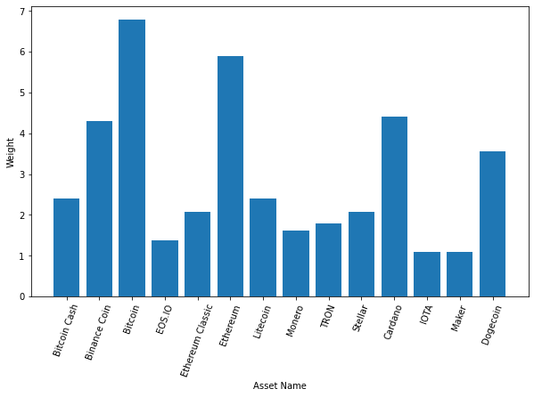
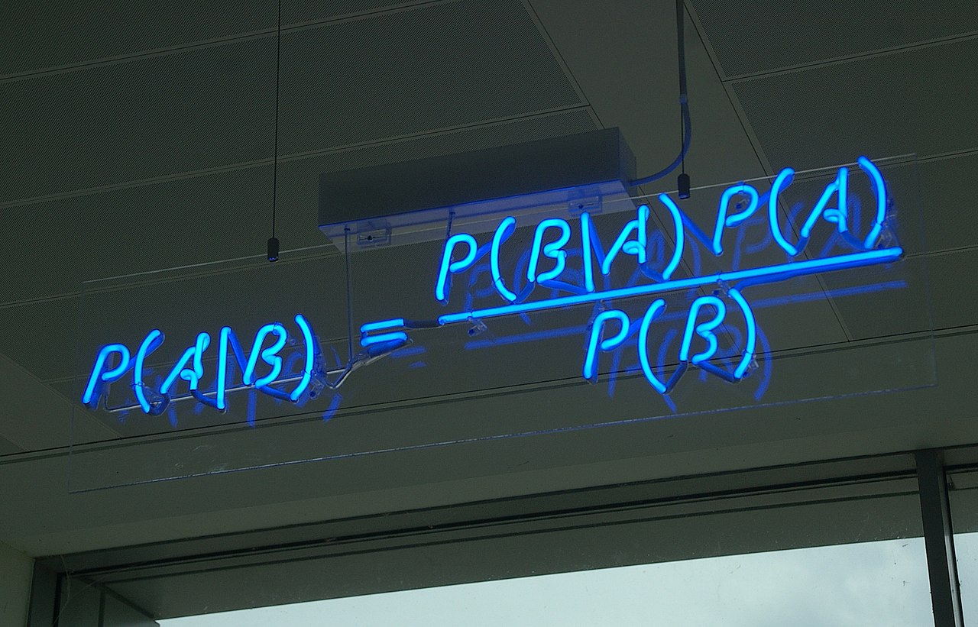
We then measured the impact
Are there any significant differences between the initial model versus the complex model,
what are the parameters that we need to consider in comparing those methods and how they both performed in terms of data.
If complex technique performed better then how much??

Slide 9
Upon measuring the impact differences, we as ML engineers knew there was no short comings, so again we have to tune our model​
We can use grid search method to find the optimal hyperparameter which results in most accurate prediction . | Grid Search Tries all possible combination of hyperparameters hence it might increase the time complexity .​ | We can also use Random Search.

Slide 10
A SATISFIED CUTOMER
After tuning our model, We then cross evaluate→ if this was good enough to replace the existing technique of the simple heuristic​

Slide 11



Stuck ?
I would re-visit the hypothesis and potentially I would re-visit the problem to check if I was missing anything ​
If you get to the step 7 and you can't beat the heuristic, you may need to either one invest in a more complex technique or two re-look at what features we are looking at in terms of your model​
Finally, we will make sure to tie it back to some meaningful business objective.​

Slide 12
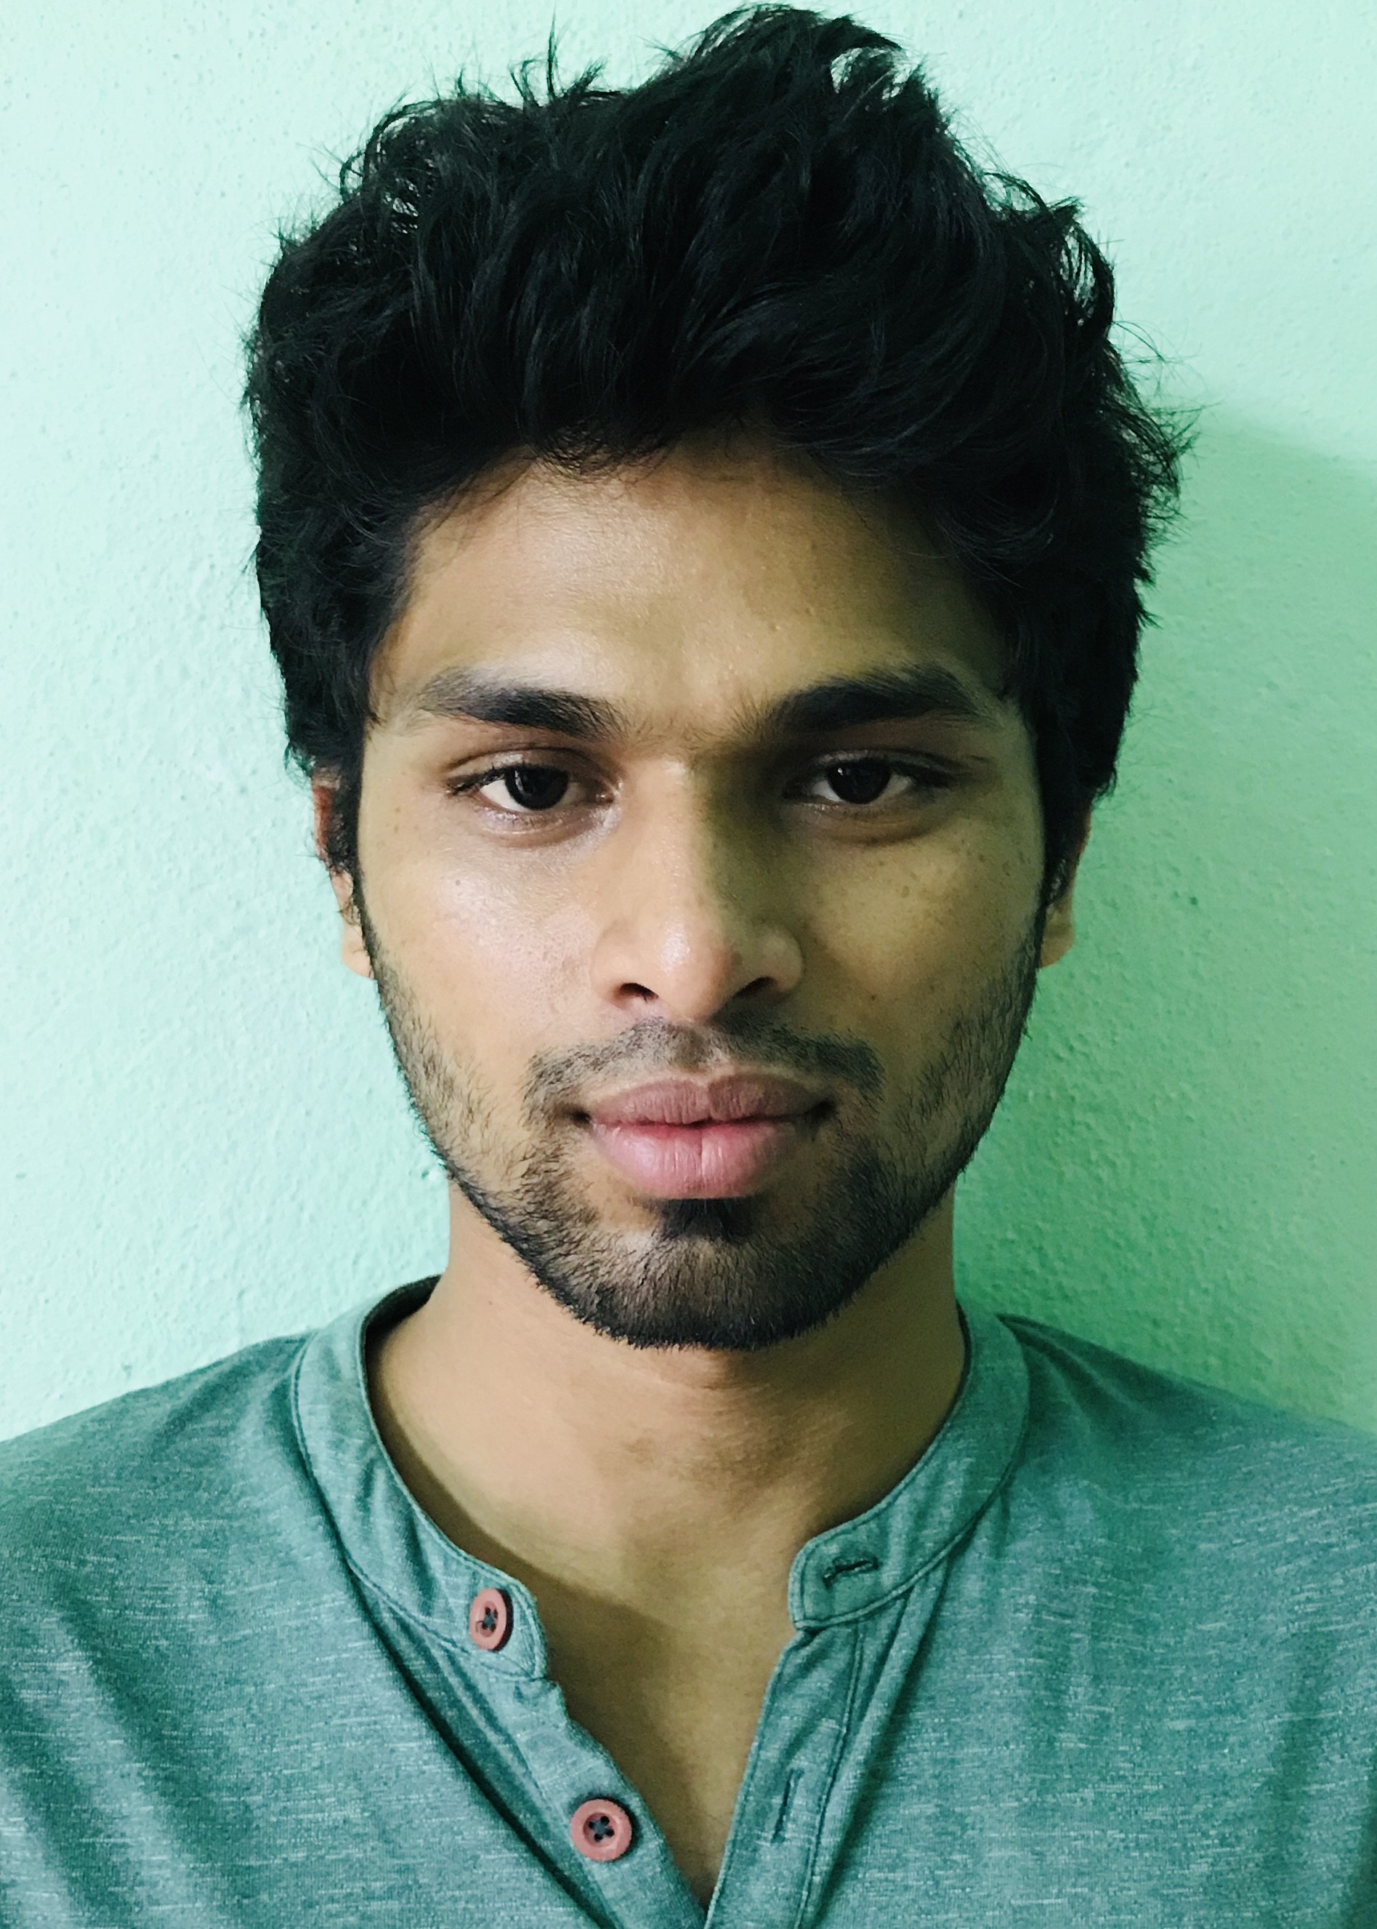

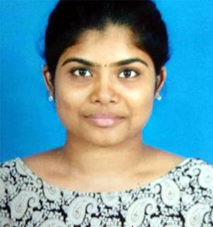
Meet the team
Satish Gollu
win :​966588920
satish.gollu@wmich.edu
Madhurima Biswas
win:​458122293
Madurima.biswas@wmich.edu
Ramya Krishna Vadlamudi
(win:​090140203)
Ramyakrishna.vadlamudi@wmich.edu

Slide 13

What’s next
LOOKING AHEAD

Slide 14
THANK YOU Any Questions?

